Slide 1

Using metrics to gain insights into born-digital archival workflows
Lara Friedman-Shedlov| Digital Records Archivist | ldfs@umn.edu
Carol Kussmann | Digital Preservation Analyst |kussmann@umn.edu
1
1
1

Slide 2
BACKGROUND
Institutional Context
Initial motivation for time tracking
Understanding workload
Understanding processes
Making the case for additional resources
Electronic Records Management Group
ASC Staff
from 15 units
Digital Records Archivist
2
2
2

Slide 3
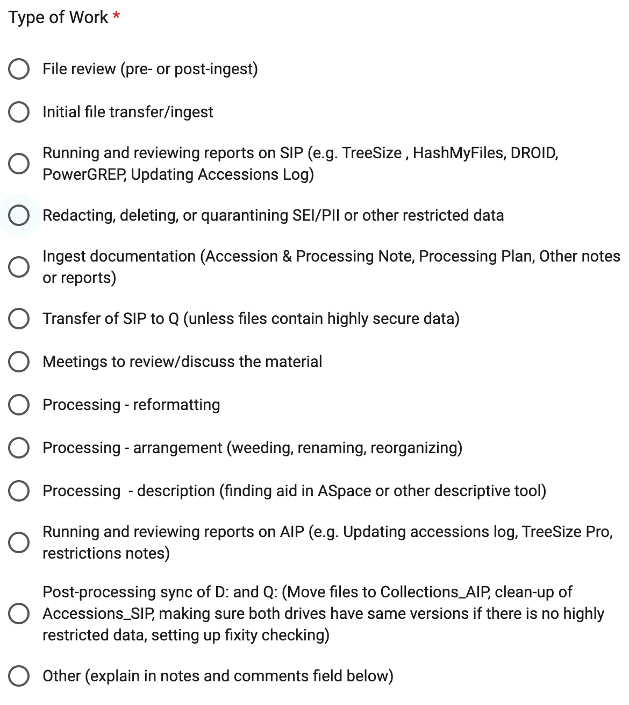
DATA COLLECTION METHOD
Google form feeding into spreadsheet
  Categories of work
  Time in minutes
Accession tracking log
  Size at ingest
  Size after processing
3
3
3
3
3
3
3

Slide 4
WHAT WE HOPED THE DATA MIGHT TELL US
Is there any factor that can be used to estimate the time needed to ingest and process a collection? (Size?)
Does the amount of time it takes to complete certain tasks or projects change over time?
  Evidence of efficiencies developing?
How long do you think it will take to make the materials accessible?
4
4
4

Slide 5
LIMITATIONS - DATA COLLECTION
Data collection form not designed with research questions in mind
Ambiguous task categories
Accuracy and granularity of time tracked
“Work time” vs “machine time”
5
5
5

Slide 6
LIMITATIONS - SIZE DATA
Tracked by # of bytes (storage space), not the number of files
  Number of files is not a good indicator of size
  Zip and/or other archive files
Merging
  multiple accessions for processing
  accruals into existing collections
6
6
6

Slide 7
DATA OVERVIEW
120 projects (accessions/collections) tracked over 4 years
  111 projects ingested
  55 projects completely processed
Largest 12 TB, smallest 400 KB (at ingest)
  40% (46) < 1 GB , 80% (88) <100 GB
  Only 4 projects > 1 TB
Time to completely process ranges from 10 to 3,382 minutes
  302 minutes per project (average)
  .75 minutes per GB (average)
Overall reduction of 80% in storage size after processing
7
7
7
7

Slide 8
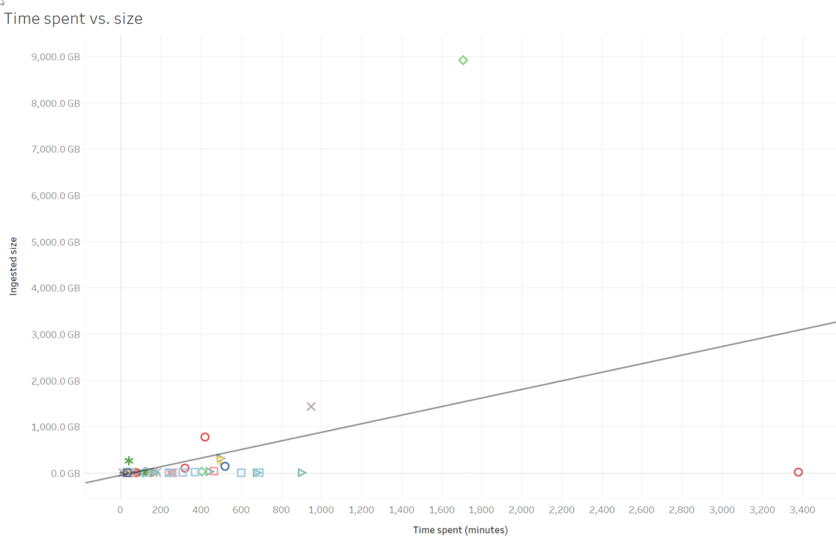
Bigger projects take longer, in general
Does size predict time to process?
0-9000 GB
0-3400 minutes
Shows all fully
processed projects

Slide 9
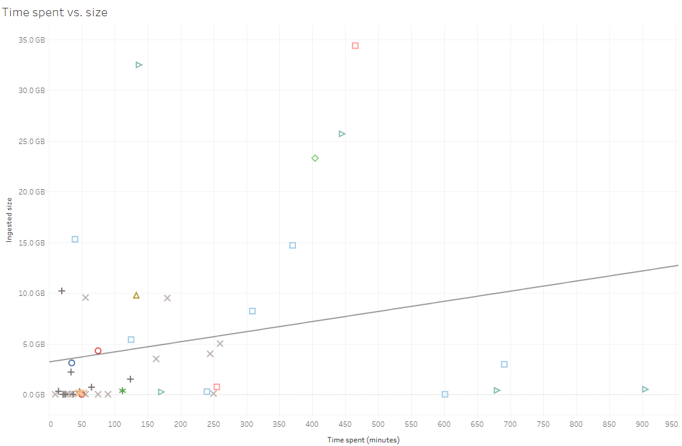
Bigger projects take longer, in general, close up view
0-50 GB
0-950 minutes
Shows all fully
processed projects up to 50GB at ingest

Slide 10
But there are many outliers
0-50 GB
0-950 minutes
Shows all fully
processed projects up to 50GB at ingest

Slide 11
MEDIA TYPE AND NUMBER MATTERS
What metrics can be used to estimate the time needed?
Project | Media Type/Count | Size (GB) | Time (min) (transfer/ingest)
N300 | 100 disks | 47 | 510
MSS095 | 75 floppy/optical disks | 40 | 517
UA2023-0064 | 10 dvds | 34 | 390
Tretter-361 | 1 Network drive | 13 | 13
SWHA349 | 1 Flash drive | 32 | 7
Projects 10-50 GB at ingest)

Slide 12
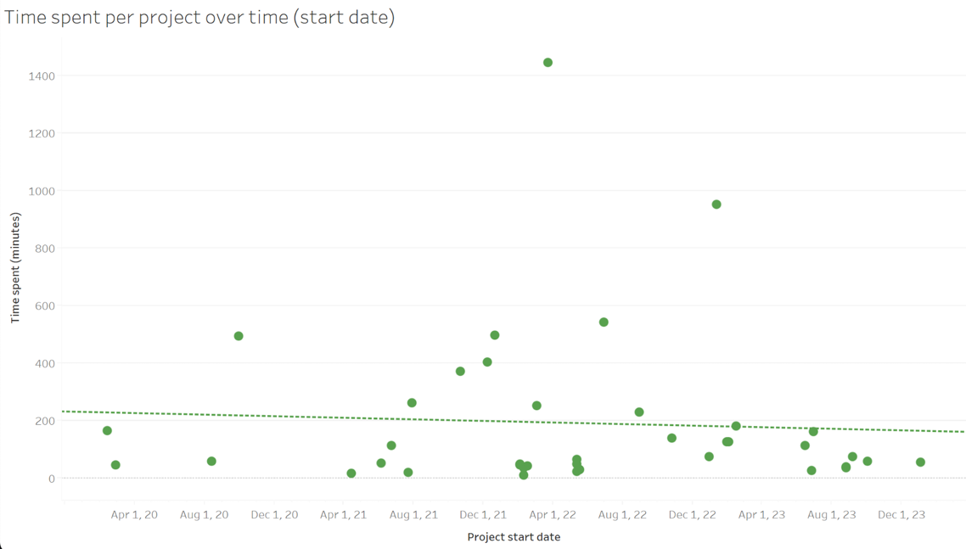
EFFICIENCY, ALL STEPS
Did the data show that we got more efficient over time?
Graphs reflects all steps, all projects

Slide 13
EFFICIENCY
We did harder accessions later
Data doesn’t reflect different media types/number
  same size & number of files on many floppies or optical disks vs. 1 hard drive
More projects in later years
  2020 - 6 projects
  2021 - 14 projects
  2022 - 40 projects
  2023 - 53 projects
13
13
13
13

Slide 14
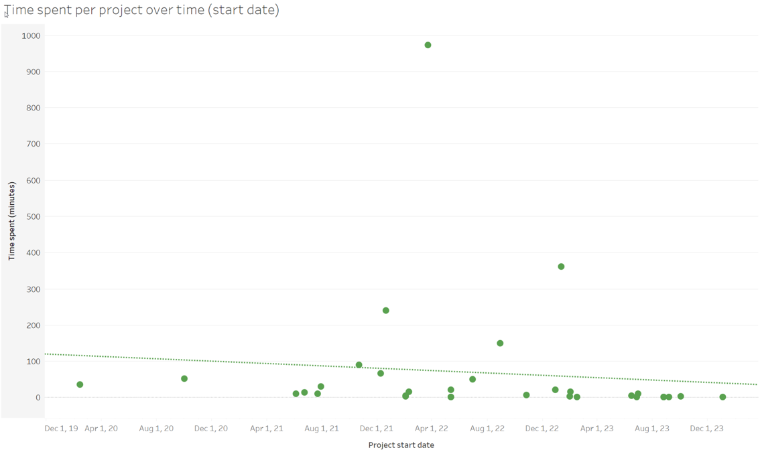
EFFICIENCY, TRANSFERRING TASK
Did the data show that we got more efficient over time?
Graph reflects one step, all projects

Slide 15
CHANGE IN SIZE AFTER PROCESSING - TABLE
Processing reduced total storage size by 80% → Processing saves storage space
Completed Projects | Total Tasks Logged | Total time Spent in Minutes | Total Ingested Size (TB) | Total Processed Size (TB) | Change in Size from Ingest to Processed (TB) | Percent change in size
55 | 427 | 16,637 | 12.12 TB | 2.44 TB | -9.69 TB | -79.9%

Slide 16
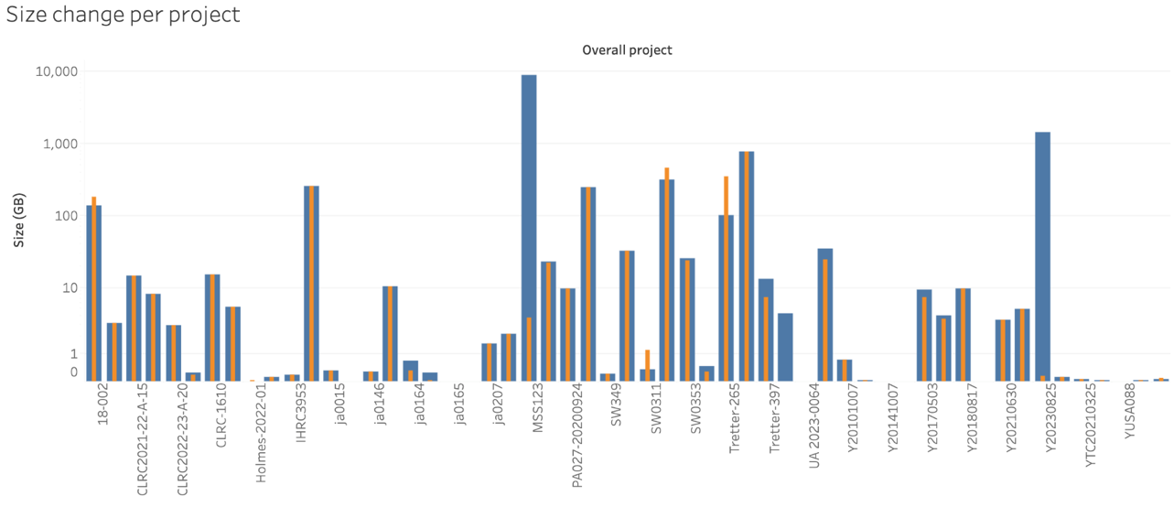
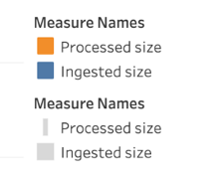
CHANGE IN SIZE AFTER PROCESSING

Slide 17
UNDERSTANDING WORKLOAD
Original data gathering goal
Identify patterns of which units are processing materials
We assume those doing the work:
  Have resources (staff/time/interest)
  Comfortable working with digital records
Potentially prioritize assisting with units that haven’t processed as much
17
17
17
17

Slide 18
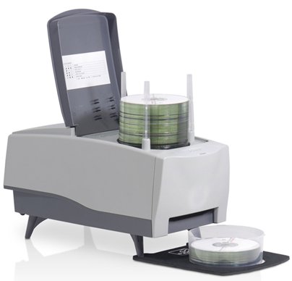
JUSTIFYING ADDITIONAL RESOURCES
Original data gathering goal
Optical disk processing improvement
Data collected time to ingest optical disks manually
Cost of staff time per disk vs. cost of Nimbie disk autoloader
Data for time to ingest optical disks with Nimbie shows it cuts ingest time in half
Transfer method | Average transfer time per disk
Manually (disk by disk) | 8.5 min
Autoloader (batch processing) | 3.8 min
https://store.acronova.com/nimbie-usb-plus-bd-cd-dvd-autoloader-nb21.html
“Assessing High-volume Transfers from Optical Media at NYPL,” 2021 (https://journal.code4lib.org/articles/15908)
18
18
18
18

Slide 19
CONCLUSIONS
Difficult to identify factors to estimate the time needed to ingest and process a collection
  Number/type of media affects ingest time
  Machine time vs. person time
  Difficult to track discrete projects (merging happens)
Time spent processing to reduce overall size of collections is valuable from a storage and sustainability perspective (80%, ~9TB/3 years)
19
19
19
19

Slide 20

SHARING OUR WORK WITH MORE DETAILS
Tracking and Analyzing Digital Records Processing Time at the University of Minnesota Archives and Special Collections
Background and overview
Data analysis
Data preparation and review
Findings
  Distribution of project size
  Storage space and impact of processing
  Relationship between project size and processing time
  Efficiency
  Passive (machine) vs. active time
Conclusion
20
20
20
20

Slide 21
NEXT STEPS
Continue tracking for longitudinal data
Refine data collection based on limitations described above
  Modify to collect / standardize information collecting
  Track number and types of media ingested
  Track machine vs active time
Re-analyze in a year or two
21
21
21
21

Slide 22
FURTHER READING
Electronic Records Management Group, University of Minnesota Libraries (2016) “Levels of Effort (for Processing Electronic Records at UMN)”: https://z.umn.edu/LevelsEffortUMN
Shein, Cyndi; Jones, Sarah R.; Kim, Tammi; and Irwin, Karla (2020) “Perspectives and Practices: Archival Processing Metrics Survey Findings.” Journal of Contemporary Archival Studies: Vol. 7 , Article 16.
Shein, Cyndi; Jones, Sarah R.; Kim, Tammi; and Irwin, Karla (2020) "Balancing the Art and Science of Archival Processing Metrics and Assessment," Journal of Western Archives: Vol. 11 : Iss. 1 , Article 1. DOI: https://doi.org/10.26077/3c95-8ef9
Weber, Chela Scott (2020) “Time Estimation for Processing Born Digital Collections,” Hanging Together: The OCLC Research Blog: https://hangingtogether.org/time-estimation-for-processing-born-digital-collections/
22
22
22
22

Slide 23

Questions?
QUESTIONS?
ldfs@umn.edu
kussmann@umn.edu
Thanks to Mark Engelmann for assistance with Tableau
23
23
23

